Slide 1
A Recursive Subdivision Technique for Sampling Multi-class Scatterplots

Slide 2
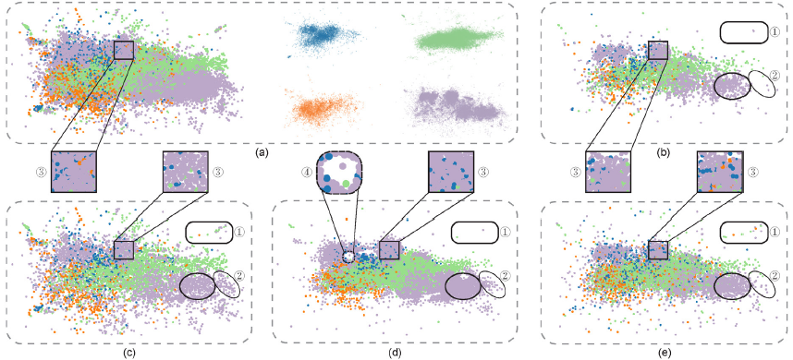
Different methods comparison
Keep major outliers
Preserve relative data densities
Preserve relative class densities
Minimize visual artifacts

Slide 3
Overdraw Reduction for Scatterplots
Related works:
Appearance optimization
Data jittering
Density estimation
Visual sampling
This work:
Work directly on data points
Relative class densities guides re-sampling

Slide 4
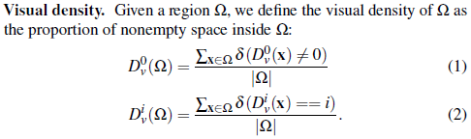
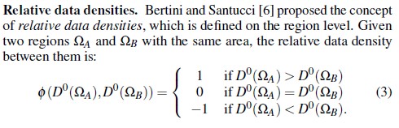
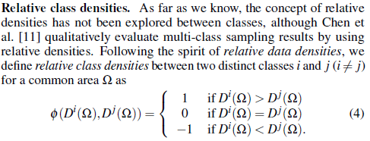
Formal definitions
Outliers:
data points in low-density areas (for multi-class scatterplots also points in high-density areas with a class different from all its nearby data points)
Local cells:
2D grid of local cells created such that the pixel region x is a local cell region in the input scatterplot domain

Slide 5
Sampling by Recursive Subdivision
Goal:
Design a non-uniform sampling technique that is able to faithfully preserve relative data densities and relative class densities, while at the same time trying to keep outliers.
Idea:
Use a kd-tree hierarchy to encode the non-uniform density distribution to maximize the preservation of relative data densities, and then to take the hierarchy to guide the multi-class sampling process for preserving relative class densities.

Slide 6
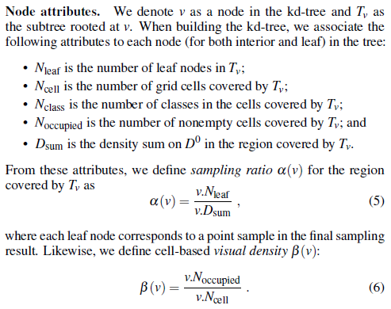
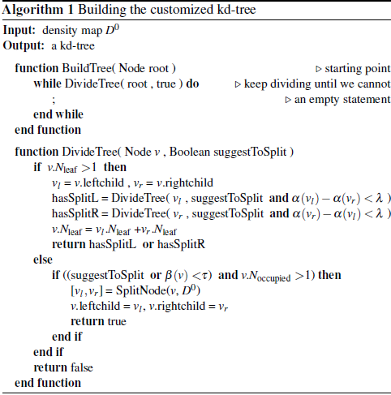
Customized KD-tree contruction
Used to subdivide the input density map into disjoint regions
Subdivision criteria:

Slide 7
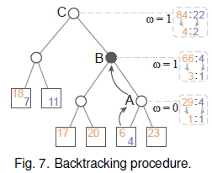
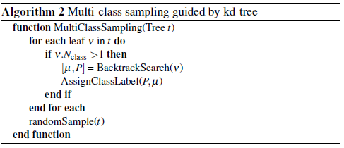
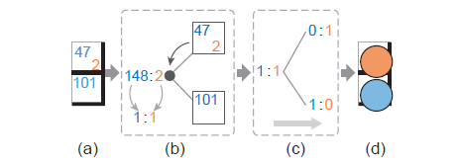
KD-tree guided multi-class sampling
Three steps:
Backtrack each leaf node to an ancestor node that has enough point samples
Assign class labels to each leaf node on the local sub-tree
Randomly sample a single data sample in each leaf with the assigned class label

Slide 8
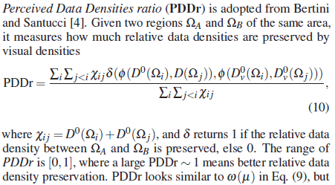
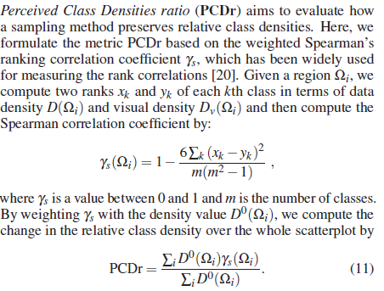
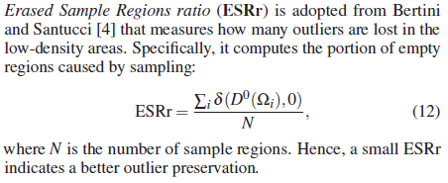
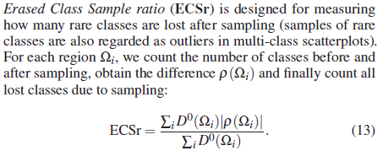
Evaluation

Slide 9
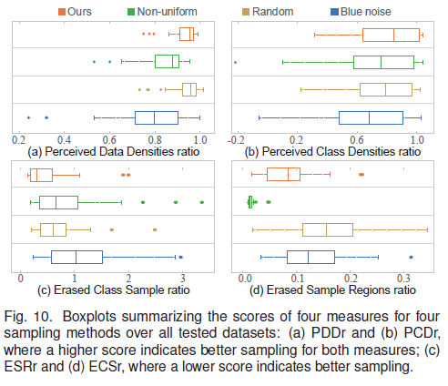
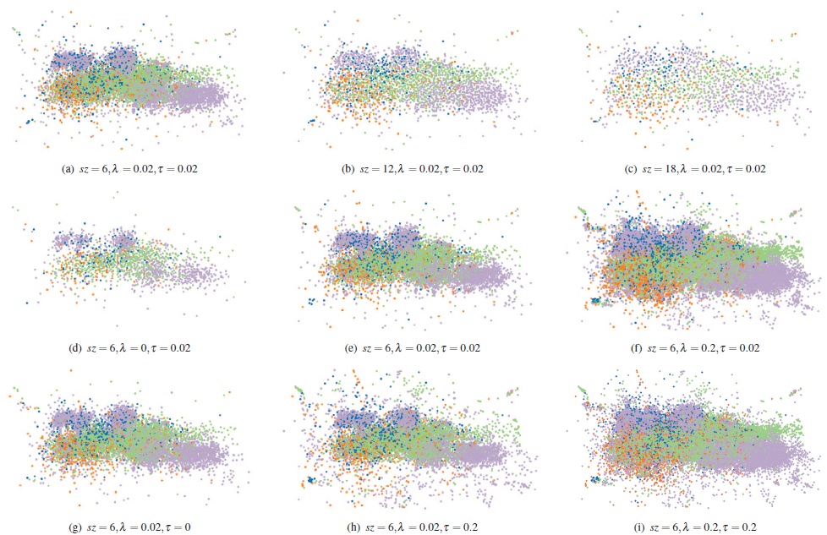
Results

